Slide 1
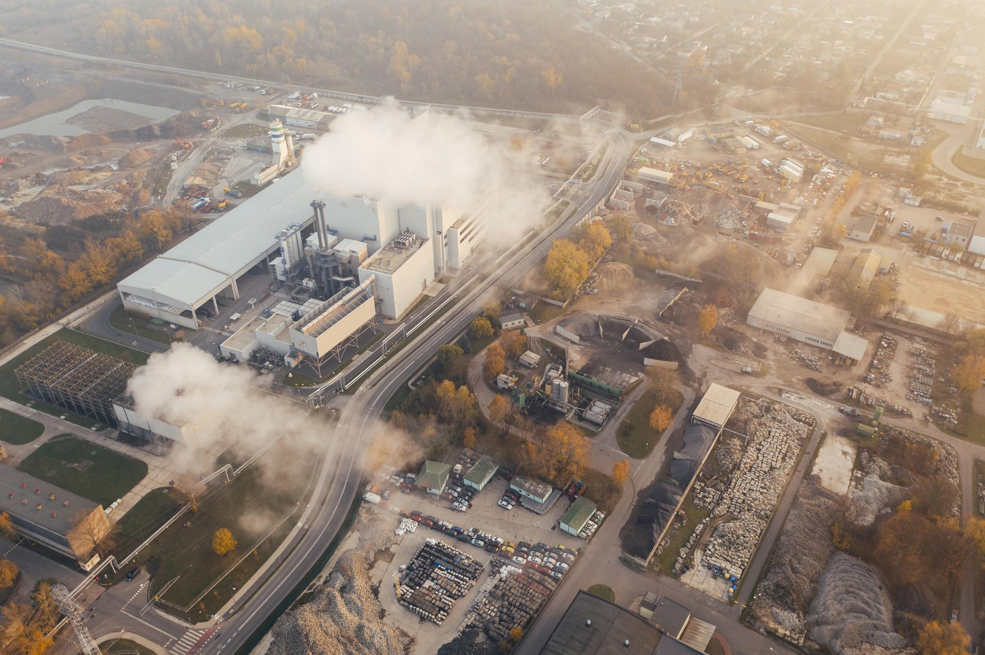
CARBON
PRICE
BDE (Big Data Energy)
Jack Craft - Project Manager
Jacqueline Kang - Researcher and analyst
Carl Mackensen - Subject Matter Expert
Noah Suskin - Administration and researcher

Slide 2

01
03
TOPIC, HYPOTHESES
ANALYSIS, RESULTS
02
04
DATA
CONCLUSIONS

Slide 3
01
TOPIC, HYPOTHESES

Slide 4
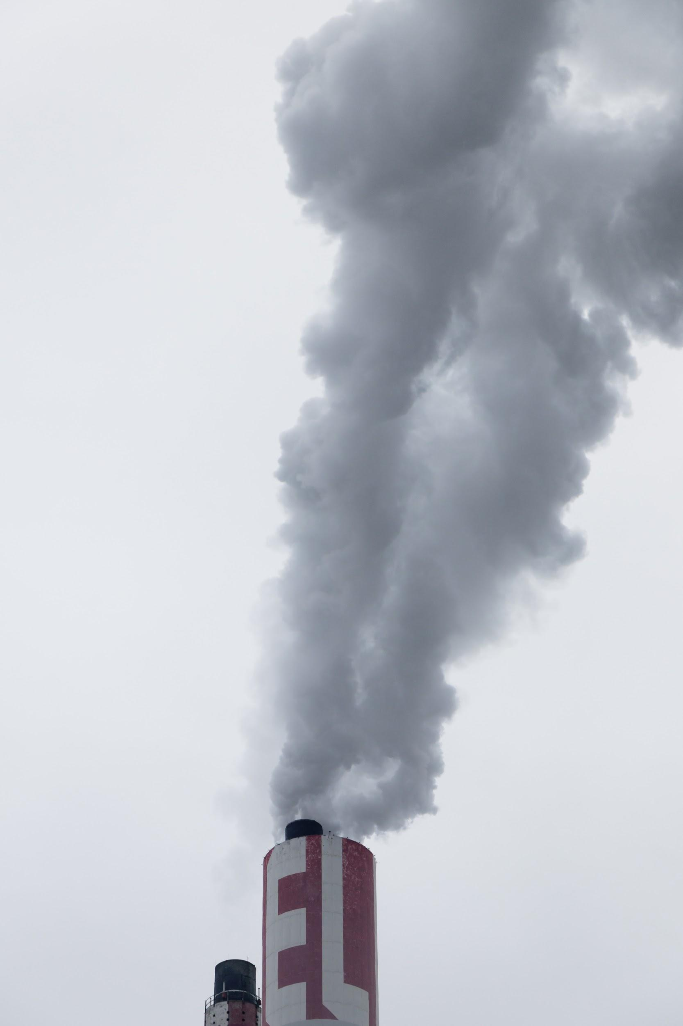
WHAT IS THIS TOPIC ABOUT?
WHAT IS THIS TOPIC ABOUT?
Looking at how Carbon Emissions are affected by other attributes.
Salient and timely: Carbon emissions & global warming are important issues moving forward.
Offers a good window into analytical tools by using a real world example.
We look at how emissions are affected by three things: a price on carbon, outdoor recreational space, and population.

Slide 5

OBJECTIVE
INTRODUCTION
We look are targeting three core relationships, analyzed via regressions, and expect negative relationships in all cases. They are:
A price on carbon and emissions.
Outdoor spaces and emissions.
Population and emissions.

Slide 6
HYPOTHESES
We have three testable hypotheses for the analytics we performed, which we sought to prove or disprove. They are:
As the price of emitting carbon increases, the amount of carbon emitted decreases.
As the value of outdoor recreation activities increase, the amount of carbon emitted per capita decreases.
As population increases, the amount of carbon emitted per capita decreases.

Slide 7
02
DATA

Slide 8
PRIMARY DATA SOURCES
U.S. Energy Information Administration(EIA) :
U.S. emissions data; producer type, energy source, Co2, So2, NOx by states (1990-2018). https://www.eia.gov/electricity/data.php#elecenv
Regional Greenhouse Gas Initiative(RGGI) :
Carbon price data for RGGI states in the US; CT, DE, MA, MD, ME, NH, NJ, NY, RI, VT) from auction results (2008-2020). https://www.rggi.org/auctions/auction-results
California Carbon Dashboard:
Carbon price for CA 5-day moving average price and volume of California Carbon Allowance Futures. https://calcarbondash.org/csv/output-csv.html

Slide 9
ADDITIONAL DATA SOURCES
CENSUS:
Population data. https://www.census.gov
BEA:
Personal Income (Millions Dollar) in 2018 & 2019, Population (Thousands of persons) in 2019, Per capita personal income in 2019. Outdoor Recreation by state. https://www.bea.gov/data/income-saving/personal-income-by-state
Carbon Price for CA:
5-day moving average price and volume of California Carbon Allowance Futures. https://calcarbondash.org/csv/output-csv.html

Slide 10









DATA CLEANING AND ASSEMBLY STEPS
PROCESS
STEP 3
Import, clean, and merge datasets.
STEP 2
STEP 4
Review data and standardize file formats.
Perform analysis.
STEP 1
STEP 5
Locate sources and download static data.
Create charts and visuals.

Slide 11
03
ANALYSIS, RESULTS

Slide 12
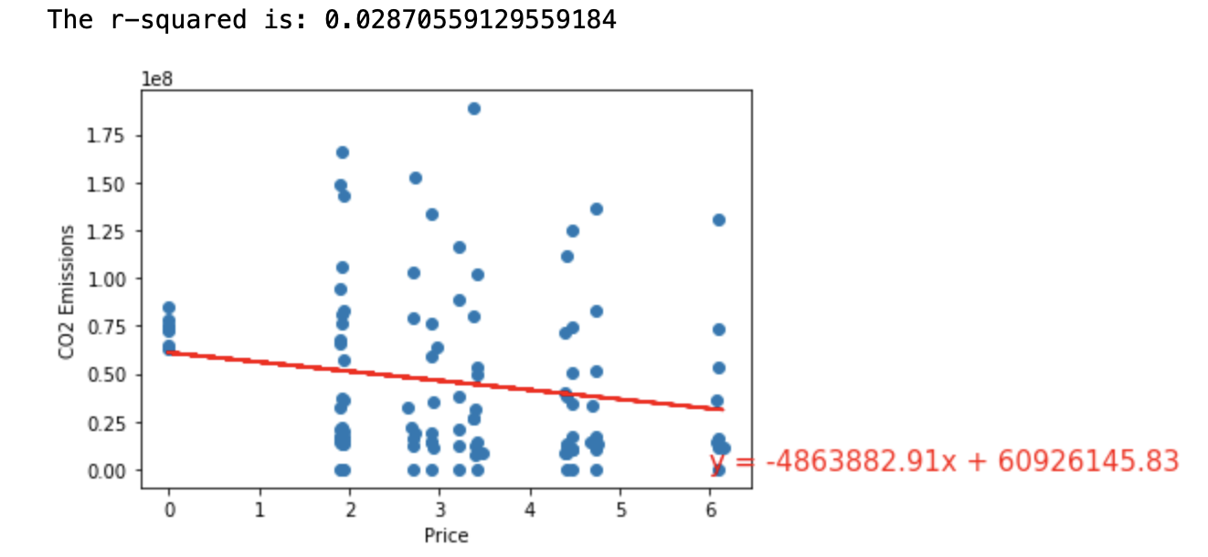
CARBON EMISSIONS VS PRICE
Some core takeaways:
A negative relationship was found. As price increases, emissions decrease.
Emissions decreased by 4,863,882.91 metric tons per dollar increase of the price.
The r-squared was low, at roughly 0.028, or explaining only 2.8% of the total variation.

Slide 13
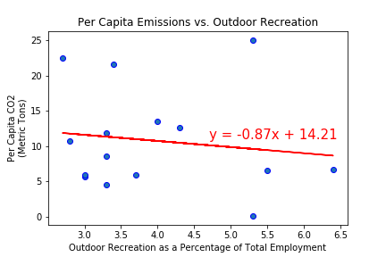
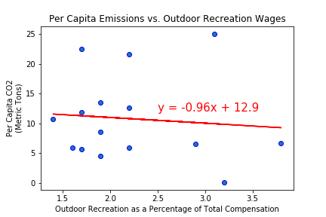
CARBON EMISSIONS VS OUTDOOR RECREATION
Some core takeaways:
The trend is slightly negative.
The correlation is very weak. R-squared is .0189 for total employment, and .0085 for total wages.

Slide 14
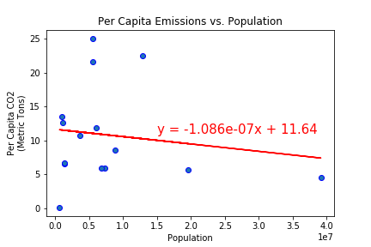
CARBON EMISSIONS VS POPULATION
Some core takeaways:
A negative relationship was found. As population increases, emissions per capita decrease.
The r-squared was low, at roughly 0.022, or explaining only 2.2% of the total variation.

Slide 15
04
CONCLUSIONS

Slide 16


PROBLEM
PROBLEM VS. SOLUTION
SOLUTION
What is the relationship between carbon emissions and other variables?
Utilizing regressions, we came to some conclusions!

Slide 17

FIRST CONCLUSION - EMISSIONS VS PRICE
DID YOU KNOW THIS?
A negative relationship was found, in line with our hypothesis.
Only 2.8% of the variation was explained by the model.
This may be because our emissions data came from all sources, not just the electricity generation industry.

Slide 18
SECOND CONCLUSION - EMISSIONS VS OUTDOOR SPACE
The data does not support our hypothesis. The correlation is negative, but very weak.
“Outdoor Recreation” includes a broad range of activities. There may be stronger correlations for more detailed subgroups of activities.

Slide 19
THIRD CONCLUSION - EMISSIONS VS POPULATION
A negative relationship was found, in line with our hypothesis.
Only 2.2% of the variation was explained by the model.
Drilling down into more detailed aspects of population size, such as population density, may yield stronger correlations.

Slide 20
NOTES FOR FUTURE WORK
It would be interesting to use emissions data from solely electricity generation.
Further study could be done into where resources from a price on carbon are spent. Do they go to the general fund? Or to Green initiatives? This likely varies by state.
What other factors influence carbon emissions? Local laws? National standards? International treaties such as Paris? This would be interesting to further examine using data.

Slide 21
THANK YOU FOR YOUR ATTENTION!
ANY QUESTIONS?

